Slide 1
Fetal circulation

Slide 3
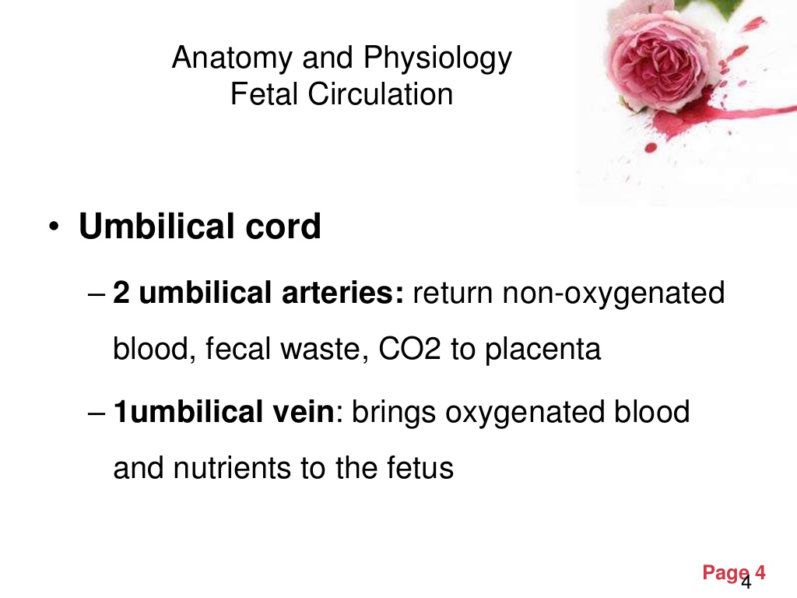

Slide 6
Fetal Circulation
Before birth, blood from the placenta, about 80% saturated with oxygen, returns to the fetus by way of the umbilical vein.
On approaching the liver, most of this blood flows through the ductus venosus directly into the inferior vena cava, short-circuiting the liver.
A smaller amount enters the liver sinusoids and mixes with blood from the portal circulation.

Slide 7
Contd…
A sphincter mechanism in the ductus venosus, close to the entrance of the umbilical vein, regulates flow of umbilical blood through the liver sinusoids. This sphincter closes when a uterine contraction renders the venous return too high, preventing a sudden overloading of the heart.
After a short course in the inferior vena cava, where placental blood mixes with deoxygenated blood returning from the lower limbs, it enters the right atrium.

Slide 8
Here it is guided towards the foramen ovale by the valve of the inferior vena cava, and most of the blood passes directly into the left atrium.
A small amount is prevented from doing so by the lower edge of the septum secundum, the crista dividens, and remains in the right atrium.
Here it mixes with desaturated blood returning from the head and arms by way of the superior vena cava.

Slide 9
From the left atrium, where it mixes with a small amount of desaturated blood returning from the lungs, blood enters the left ventricle and ascending aorta.
Since the coronary and carotid arteries are the first branches of the ascending aorta, the heart musculature and the brain are supplied with well oxygenated blood.

Slide 10
Desaturated blood from the superior vena cava flows by way of the right ventricle into the pulmonary trunk. During fetal life, resistance in the pulmonary vessels is high, such that most of this blood passes directly through the ductus arteriosus into the descending aorta, where it mixes with blood from the proximal aorta.
After coursing through the descending aorta, blood flows toward the placenta by way of the two umbilical arteries.
The oxygen saturation in the umbilical arteries is approximately 58%.

Slide 11
During its course from the placenta to the organs of the fetus, blood in the umbilical vein gradually loses its high oxygen content as it mixes with desaturated blood.
Theoretically, mixing may occur in the following places:
in the liver (I ), by mixture with a small amount of blood returning from the portal system;

Slide 12
in the inferior vena cava (II ), which carries deoxygenated blood returning from the lower extremities, pelvis, and kidneys;
in the right atrium (III ), by mixture with blood returning from the head and limbs;
in the left atrium (IV), by mixture with blood returning from the lungs;
at the entrance of the ductus arteriosus into the descending aorta (V ).

Slide 13
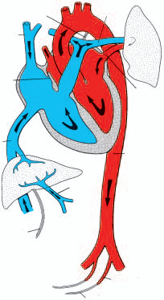
Changes seen after birth

Slide 14
Changes after the birth
A. Closure of the umbilical arteries, accomplished by contraction of the smooth musculature in their walls, is probably caused by thermal and mechanical stimuli and a change in oxygen tension.
Functionally the arteries close a few minutes after birth, although the actual obliteration of the lumen by fibrous proliferation may take 2 to 3 months.
Distal parts of the umbilical arteries form the lateral umbilical ligaments, and the proximal portions remain open as the superior vesical arteries.

Slide 15
B. Closure of the umbilical vein and ductus venosus occurs shortly after that of the umbilical arteries. Hence blood from the placenta may enter the newborn for some time after birth. After obliteration, the umbilical vein forms the ligamentum teres hepatis in the lower margin of the falciform ligament.
The ductus venosus, which courses from the ligamentum teres to the inferior vena cava, is also obliterated and forms the ligamentum venosum.

Slide 16
C. Closure of the ductus arteriosus by contraction of its muscular wall occurs almost immediately after birth; it is mediated by bradykinin, a substance released from the lungs during initial inflation.
Complete anatomical obliteration by proliferation of the intima is thought to take 1 to 3 months. In the adult the obliterated ductus arteriosus forms the ligamentum arteriosum.

Slide 17
Closure of the foramen ovale is caused by an increased pressure in the left atrium, combined with a decrease in pressure on the right side.
Crying by the baby creates a shunt from right to left, which accounts for cyanotic periods in the newborn.
Constant apposition gradually leads to fusion of the two septa in about 1 year.
In 20% of individuals, however, perfect anatomical closure may never be obtained (probe patent foramen ovale).

